Slide 1
HUMAN ACTIVITY RECOGNITION
Team name : Team Lbsa
MEMBERS:
Sai Prashanth Nagisetti
Lingojigari Bharathchandra
Kothinti Adarsh Reddy
Lokesh Karaka
Under Guidance of
Syed Jawed Shah

Slide 2
OBJECTIVES
Abstract
Introduction
Resnet-34 info
Processing
Activity detection
Output
Conclusion

Slide 3
Abstract
The problem is to predict the activity given a snapshot of sensor data, typically data from one or a small number of sensor types. Generally, this problem is framed as a univariate or multivariate time series classification task. It is a challenging problem as there are no obvious or direct ways to relate the recorded sensor data to specific human activities and each subject may perform an activity with significant variation, resulting in variations in the recorded sensor data. The intent is to record sensor data and corresponding activities for specific subjects, fit a model from this data, and generalize the model to classify the activity of new unseen subjects from their sensor data.

Slide 4
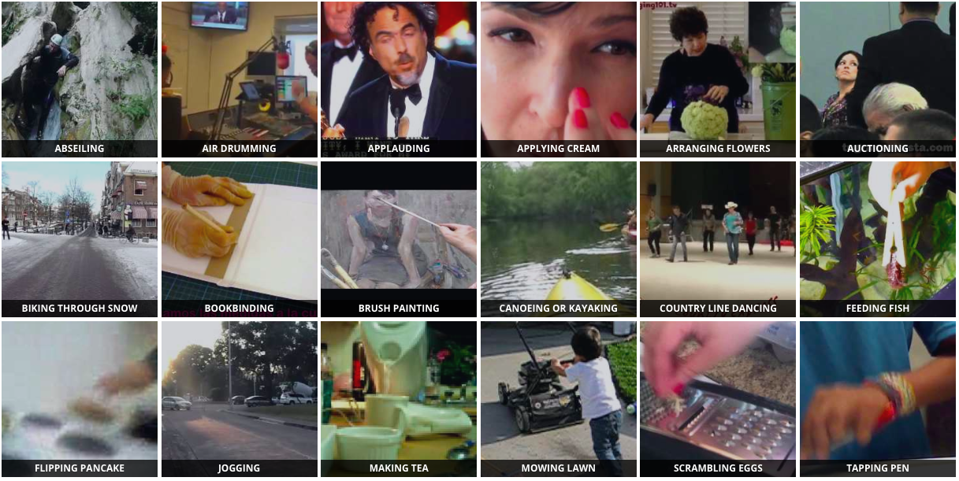
INTRODUCTION
Nowadays, human activity recognition is one of the top examined computer vision issues. The uses of Human Activity Recognition use video perception, human- computer correspondence.

Slide 5
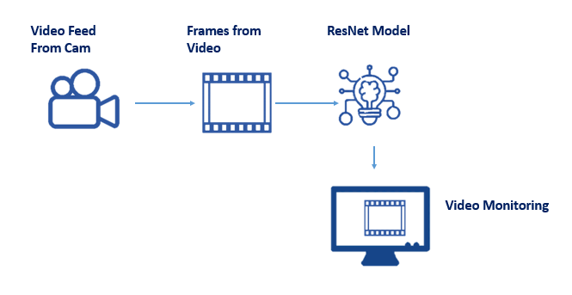

Slide 6
ResNet-34
1. ResNet-34 is a convolutional neural network (CNN) architecture that was introduced in 2015 by researchers at Microsoft Research Asia for image classification.
2. The architecture contains 34 layers, including convolutional layers, pooling layers, and fully connected layers. ResNet-34 is a variant of the original ResNet architecture, which is known for its deep residual learning approach that enables the training of very deep neural networks with improved accuracy.
3. ResNet-34 is widely used as a backbone for various computer vision tasks such as object detection, segmentation, and action recognition.

Slide 7
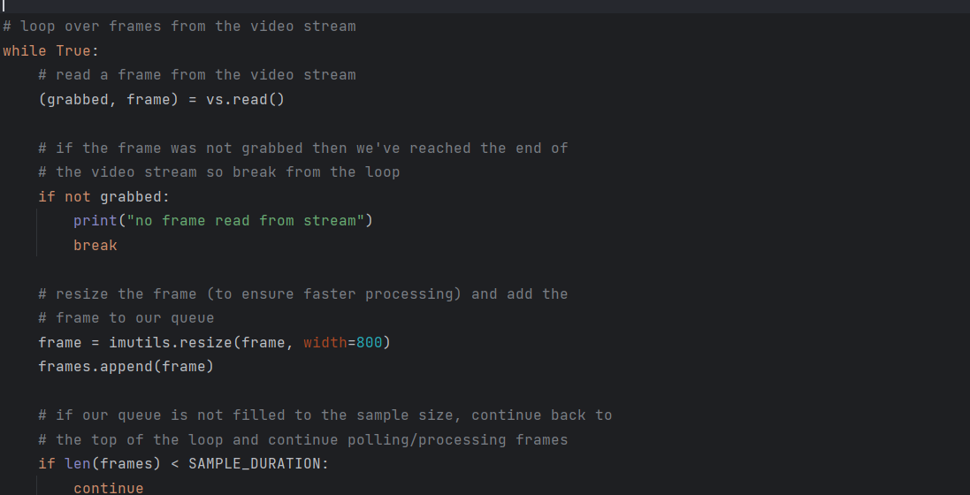
Processing

Slide 8
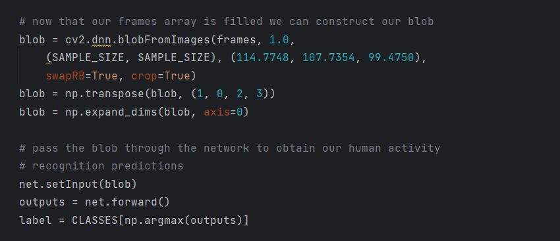
Activity Detection

Slide 9
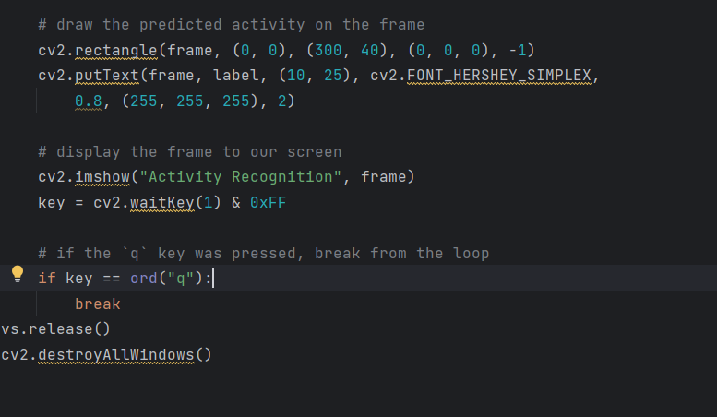
Producing results

Slide 10
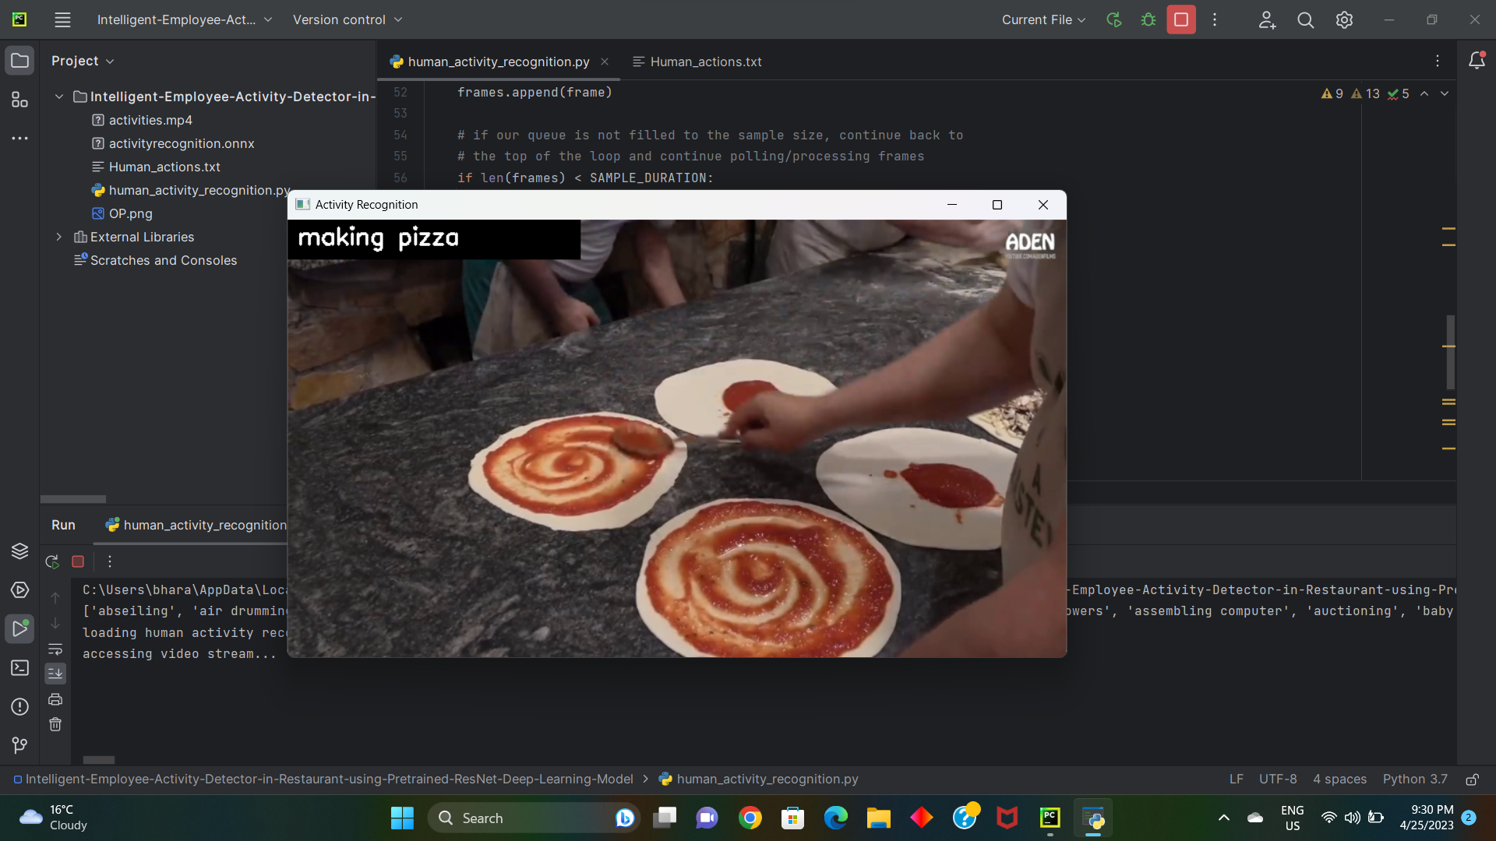
Results

Slide 11
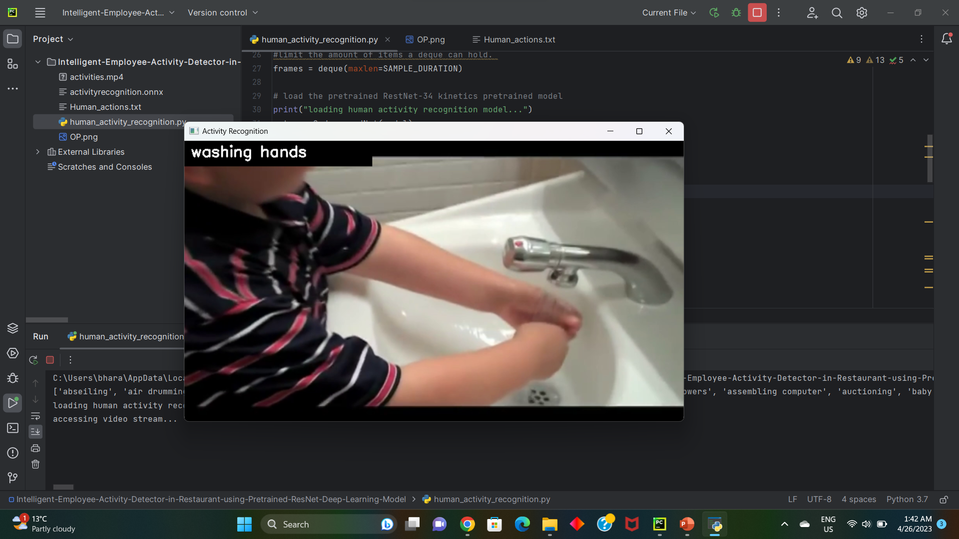
Results

Slide 12
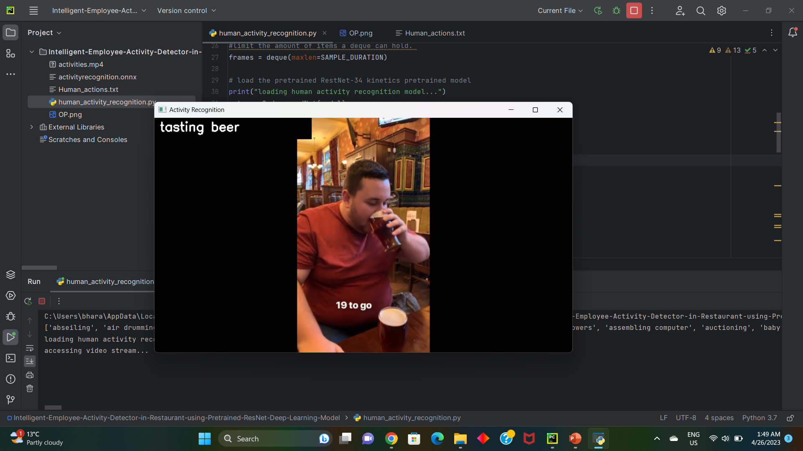
Results

Slide 13
CONCLUSION
Overall accuracy will increase, and application improvements become very qualified to perform human activity recognition with confidence.

Slide 14


Slide 15


